Slide 1
CS 451/551
Spring 2025

Slide 2
Stack vs Heap
WTF are the stack and heap?!
Stack
Memory where values are pushed and popped in a LIFO manner
The stack grows only by known sizes. I.e., you have to know the size of a value (and it can’t change) before you push it onto the stack
Memory is always in contiguous blocks and thus the stack is fast
Heap
Dynamically allocated
You request how much memory you want
Get a pointer in return

Slide 3
Stack vs Heap
Doing stuff on the heap is (relatively) expensive!
Why?!?
WTF are the stack and heap?!
Stack
Memory where values are pushed and popped in a LIFO manner
The stack grows only by known sizes. I.e., you have to know the size of a value (and it can’t change) before you push it onto the stack
Memory is always in contiguous blocks and thus the stack is fast
Heap
Dynamically allocated
You request how much memory you want
Get a pointer in return
Notes:
It’s non contiguous. Following a pointer is expensive. Then, whenever you allocate stuff, you have to find an open block of memory, allocate it, mark it as in use, etc. etc. etc. if something it’s easy to push stuff onto the stack.

Slide 4
Ownership and memory management
One of the best features of Rust is that it is extremely safe wrt memory
How does it do this without having a garbage collector?
C is certainly a nightmare wrt memory management
Rust uses an innovative concept known as ownership
Basically, a variable is owned by whatever scope it is passed into
This is dope, because the compiler knows that when a variable goes out of scope, it’s safe to free it
That said, it can lead to some complicated compiler errors and you need to think about what is going on.

Slide 5
Ownership Rules
Each value in Rust has a variable that is its owner.
There can be only one owner at a time.
When owner goes out of scope → the value is dropped

Slide 6
Ownership Rules
Simple! No risk of double frees, no dangling pointers, etc.
Each value in Rust has a variable that is its owner.
There can be only one owner at a time.
When owner goes out of scope → the value is dropped

Slide 7
Ownership Rules
But it’s a different mental model that can take some time to adjust to
Each value in Rust has a variable that is its owner.
There can be only one owner at a time.
When owner goes out of scope → the value is dropped

Slide 8
Notes:
s comes into scope
s loses scope and thus dropped.

Slide 9
What type is s?
Notes:
s comes into scope
s loses scope and thus dropped.

Slide 10
New scope
Notes:
s comes into scope
s loses scope and thus dropped.

Slide 11
s comes into scope
Notes:
s comes into scope
s loses scope and thus dropped.

Slide 12
s goes out of scope
Notes:
s comes into scope
s loses scope and thus dropped.

Slide 14
What type is s?

Slide 15
Memory is allocated (because it’s not a string literal)
pointer returned, and s is valid for use.

Slide 16
s goes out of scope, it’s value is dropped and s is no longer valid for use.

Slide 17
What happens when going out of scope?
A special function called drop() is called
This is kind of like a deconstructor in C++ if you’ve ever seen that
drop() is responsible for doing any additional clean up that might be necessary

Slide 18
Variable/Data Interaction: Move

Slide 19
Variable/Data Interaction: Move
What’s happening here?

Slide 20
Variable/Data Interaction: Move
What’s happening here?

Slide 21
Variable/Data Interaction: Move
What’s happening here?

Slide 22
Variable/Data Interaction: Move
What’s happening here?

Slide 23
Variable/Data Interaction: Move
Primitive and fixed size values are (typically) pushed onto the stack
Data is copied.
Like you have to assume a memcpy() is happening
memcpy() might not actually happen; that’s compiler optimization stuff
Non-primitive (non-fixed sized) values have to be allocated via the heap
Let’s reason about this a bit…

Slide 24
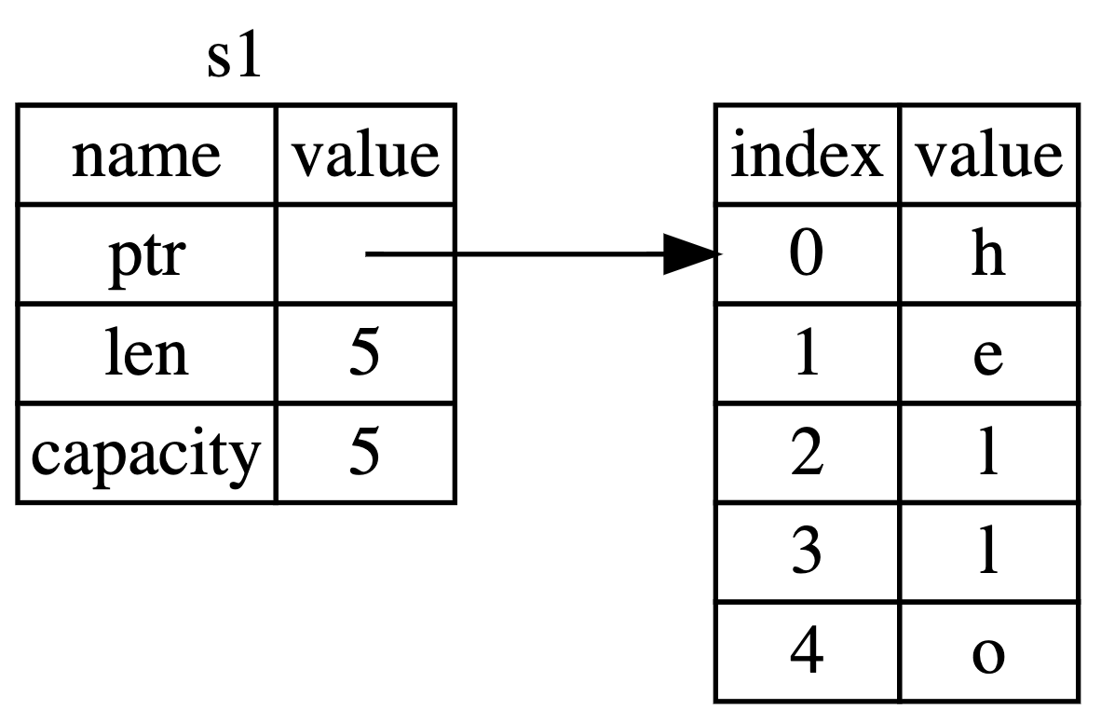
Variable/Data Interaction: Move

Slide 25
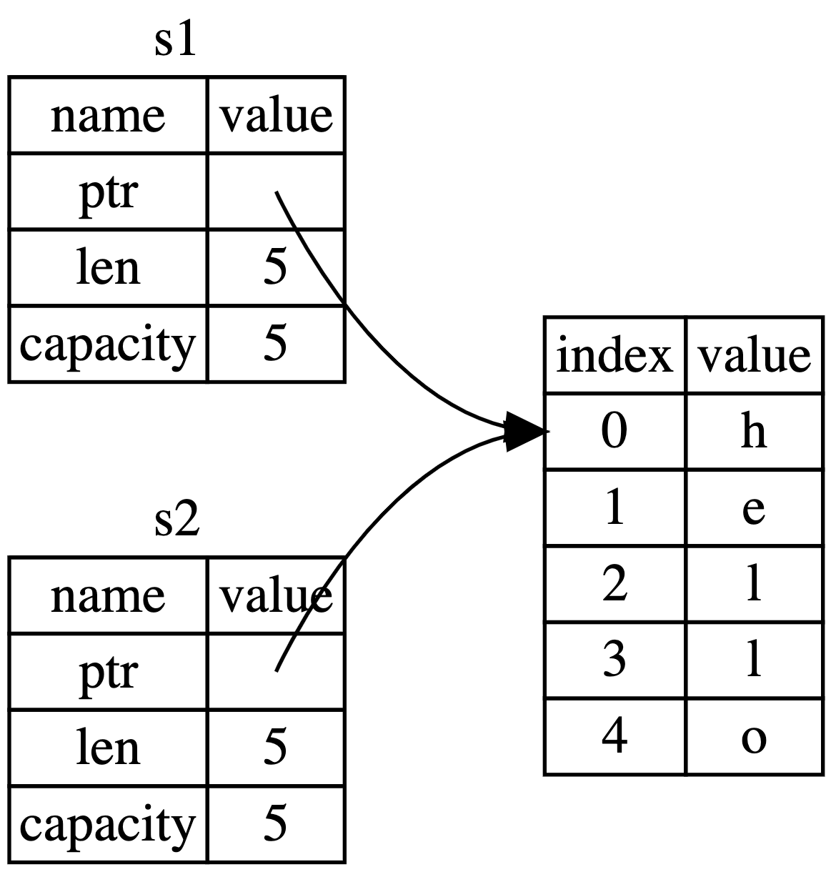
Variable/Data Interaction: Move

Slide 26
Variable/Data Interaction: Move
Let’s say the pointer, length, and capacity are all copied in the stack, but the value of the pointer (i.e., where it points to in the heap) remains the same

Slide 27
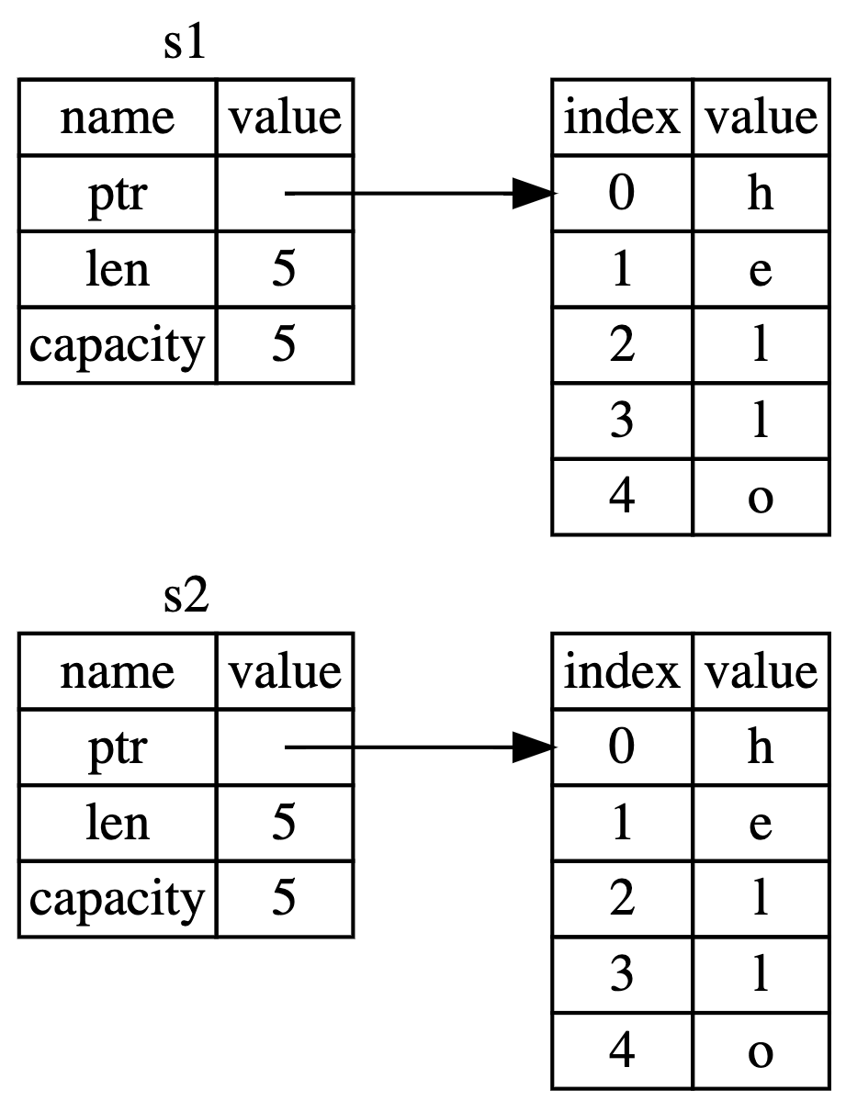
Variable/Data Interaction: Move

Slide 28
Variable/Data Interaction: Move
There is *NOT* an additional copy of the data made on the heap itself.

Slide 29
Ok… So what?
The problem is that when both s1 and s2 go out of scope, they will try to free the same data!
This is very bad! Double frees are a massive security vulnerability
Remember rule 2: there can only be one owner at a time!
To deal with this, instead of copying data, marks the original variable as invalid and moves its contents in the new variable.
The new variable owns the value now

Slide 30
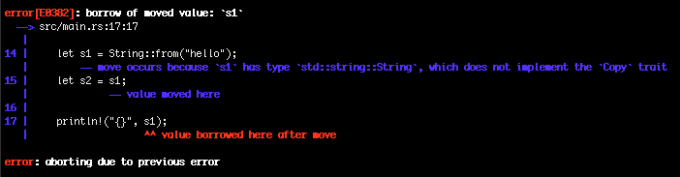
Ok… So what?
The problem is that when both s1 and s2 go out of scope, they will try to free the same data!
This is very bad! Double frees are a massive security vulnerability
Remember rule 2: there can only be one owner at a time!
To deal with this, instead of copying data, marks the original variable as invalid

Slide 31
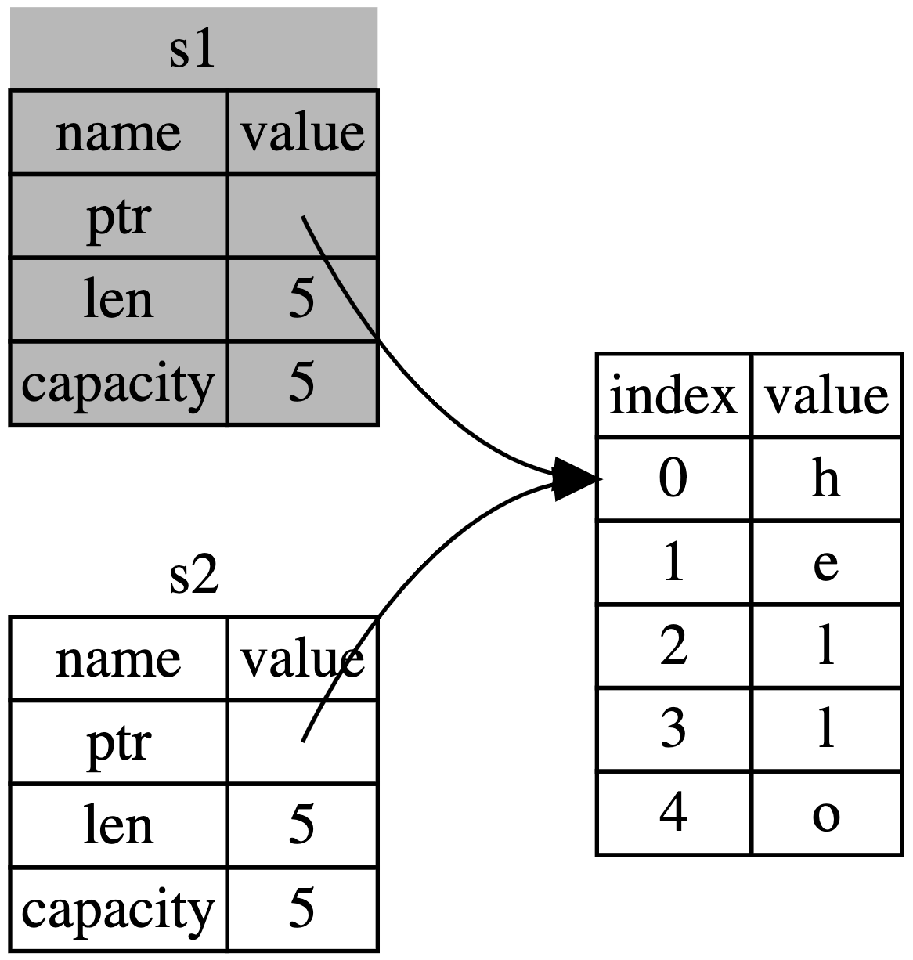

Slide 32
s1 becomes invalidated.
It is no longer the owner of the data, and thus it can’t do anything with the data

Slide 33
Variable/Data Interaction: Clone
The example that we just covered with the strings is called a shallow copy
Some meta data is copied, but, the actual data itself isn’t
This has some serious performance advantages
Like what?
Sometimes you want a deep copy
All the data is copied as well
In Rust, this is handled by calling the clone() method

Slide 34
Variable/Data Interaction: Clone
The example that we just covered with the strings is called a shallow copy
Some meta data is copied, but, the actual data itself isn’t
This has some serious performance advantages
Like what?
Sometimes you want a deep copy
All the data is copied as well
In Rust, this is handled by calling the clone() method

Slide 35
Variable/Data Interaction: Clone
clone() makes a deep copy of the String
All data will be copied
The example that we just covered with the strings is called a shallow copy
Some meta data is copied, but, the actual data itself isn’t
This has some serious performance advantages
Like what?
Sometimes you want a deep copy
All the data is copied as well
In Rust, this is handled by calling the clone() method

Slide 36
Variable/Data Interaction: Clone
The example that we just covered with the strings is called a shallow copy
Some meta data is copied, but, the actual data itself isn’t
This has some serious performance advantages
Like what?
Sometimes you want a deep copy
All the data is copied as well
In Rust, this is handled by calling the clone() method

Slide 37
Ownership & Functions
This is where things get tricky
We said that only one variable can have ownership over a value
What happens when we send a variable to a function as a parameter?
Function → new scope, and we are sending the value into that new scope…
Function gains ownership of the value!

Slide 39
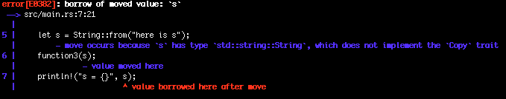

Slide 40
s comes into scope in main()

Slide 41
Ownership of s is given to function3()

Slide 42
s goes out of scope from function()
Without returning ownership to main()

Slide 43
This only happens with values that are on the heap!
Primitives and things that go on the stack do not transfer their ownership, because no memory has to be deallocated from the heap

Slide 44
How to deal with ownership
Return the variable that had ownership transferred

Slide 45
How to deal with ownership
Return the variable that had ownership transferred

Slide 46
How to deal with ownership
Return the variable that had ownership transferred
Use a reference

Slide 47
How to deal with ownership
Return the variable that had ownership transferred
Use a reference

Slide 48
How to deal with ownership
Return the variable that had ownership transferred
Use a reference
function5() now takes a reference to a string as a parameter

Slide 49
How to deal with ownership
Return the variable that had ownership transferred
Use a reference
This means that function5() is borrowing s and will automatically return ownership to the enclosing scope

Slide 50
How to deal with ownership
Return the variable that had ownership transferred
Use a reference
Note that we have to make sure we send a reference into function5()
The compiler will complain if we don’t

Slide 51
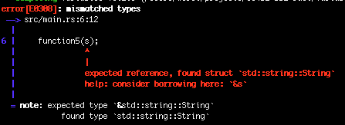
How to deal with ownership
Return the variable that had ownership transferred
Use a reference
Note that we have to make sure we send a reference into function5()
The compiler will complain if we don’t

Slide 52
Exercises

Slide 53
Exercises

Slide 54
Exercises
Will it compile?

Slide 56
Will it compile?

Slide 58
Will it compile?

Slide 60
Will it compile?

Slide 62
The push_str() method on String appends to the string

Slide 63
Will it compile?

Slide 64
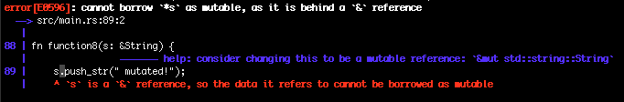
Will it compile?

Slide 65
Will it compile?
Immutability is still enforced with references

Slide 67
We have to annotate that our function is going to take in a reference to a mutable variable

Slide 68
Declare our variable to be mutable

Slide 69
We also have to use the mut keyword when sending a variable into a function

Slide 70
A caveat with mutable references
There can only be one mutable reference to a piece of data in a given scope!

Slide 71
A caveat with mutable references
There can only be one mutable reference to a piece of data in a given scope!

Slide 72
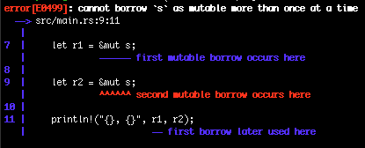
A caveat with mutable references
There can only be one mutable reference to a piece of data in a given scope!
Notes:
Check on ownership return nwithin same scope for mutable references

Slide 73
A caveat with mutable references
There can only be one mutable reference to a piece of data in a given scope!

Slide 74
A caveat with mutable references
There can only be one mutable reference to a piece of data in a given scope!
No problems!

Slide 75
Dangling References
Big problem in many systems programming languages (C/C++ in particular) is dangling pointers
Happens when you have a pointer to memory that someone else might have free()d
Not possible in Rust!
Except with unsafe Rust ☺

Slide 76
Dangling References
Big problem in many systems programming languages (C/C++ in particular) is dangling pointers
Happens when you have a pointer to memory that someone else might have free()d
Not possible in Rust!

Slide 77
Dangling References
s comes into scope, and memory is allocated on the heap
Big problem in many systems programming languages (C/C++ in particular) is dangling pointers
Happens when you have a pointer to memory that someone else might have free()d
Not possible in Rust!

Slide 78
Dangling References
Big problem in many systems programming languages (C/C++ in particular) is dangling pointers
Happens when you have a pointer to memory that someone else might have free()d
Not possible in Rust!
s goes out of scope, and thus the memory on the heap is freed
A reference to s now points to a bad memory location

Slide 79
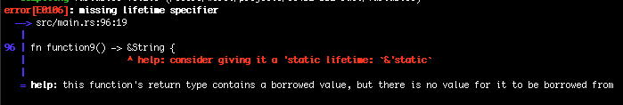
Dangling References
Big problem in many systems programming languages (C/C++ in particular) is dangling pointers
Happens when you have a pointer to memory that someone else might have free()d
Not possible in Rust!

Slide 80
Dangling References
Compiler stops us from making this mistake
Big problem in many systems programming languages (C/C++ in particular) is dangling pointers
Happens when you have a pointer to memory that someone else might have free()d
Not possible in Rust!

Slide 81
Dangling References
Big problem in many systems programming languages (C/C++ in particular) is dangling pointers
Happens when you have a pointer to memory that someone else might have free()d
Not possible in Rust!
We can fix this by just returning s instead of &s as well as changing the return type to just be a String
Compiler mentions other stuff… We’ll talk more later, and a bit right now

